Slide 1








IEEE IC HACK 2.0
TEAM:
VISION
EXPLORERS
“ALERTEYE “
- Revolutionizing Road Safety
DEEP LEARNING BASED
driver drowsiness, unease, or sleepiness detection model

Slide 2


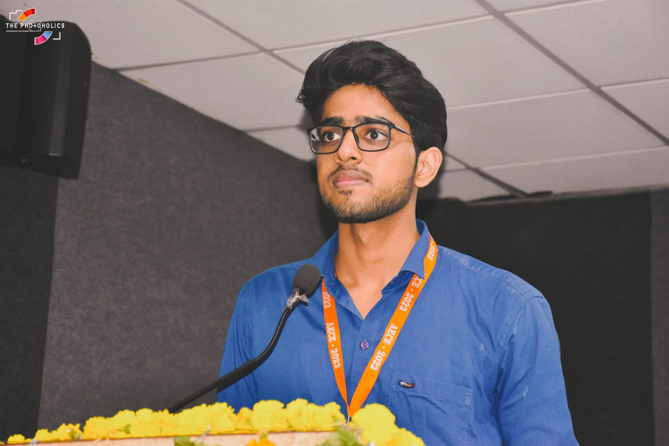



Our Team
Yuvraj Yash Garg
Anshika Tiwari
Sahil Keshari
Priyanshu Srivastava
( Team Lead )
Secretory
Robotics Engineer
AI Engineer
Member
IEEE SB RKGIT
Final Year CSE - AI/ML
Final Year CSE - AI/ML
IEEE SB RKGIT
UP SECTION
RKGIT
RKGIT
UP SECTION

Slide 3
TABLE OF CONTENT
01
Problem Statement
02
Idea
Overview
03
Market
Prospectus
04
Technical
Overview
Execution
06
Future
Scope
05

Slide 4

Our Vision
"Our mission is to revolutionize road safety by leveraging advanced AI technology."
Long Term Goals :-
To drastically reduce the number of accidents caused by driver drowsiness and fatigue.
To make road travel safer for all by preventing accidents before they happen.
To create a world where AI-driven technology actively protects and assists drivers

Slide 5



PROBLEM STATEMENT
01
To Develop a Machine Learning/Deep Learning algorithm capable of analyzing video feeds from an in-car camera and accurately detecting instances of driver drowsiness, unease, or sleepiness. The goal is to create a complete prototype that can be integrated into vehicles to enhance road safety.

Slide 6
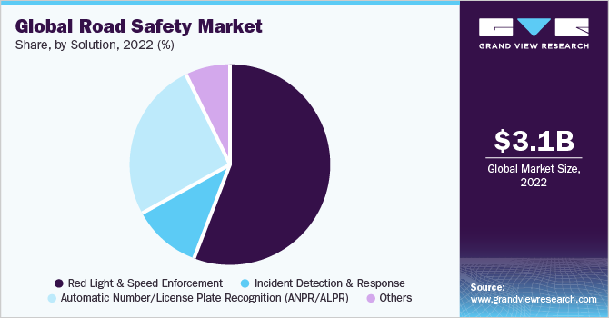

TARGET MARKET
Our target market spans various industries, including automotive, transportation, logistics, and public transportation.
The total addressable market (TAM) for road safety solutions is estimated at $3.1B with a projected annual growth rate of 12.40%.
Increasing awareness of road safety, government regulations, and a growing demand for advanced safety features present a compelling market opportunity.

Slide 7

SOLUTION
1
2
3
ALERTEYE leverages state-of-the-art AI and deep learning algorithms to monitor driver behavior and detect signs of drowsiness, unease, or sleepiness.
Key features include real-time alerts, seamless integration into existing vehicle systems, and adaptability to diverse driving conditions.
ALERTEYE engages drivers through unobtrusive alerts, such as audio warnings or haptic feedback, allowing them to regain focus and alertness. This proactive approach helps prevent accidents before they occur.
The user interface is designed to be intuitive for both drivers and fleet operators. It provides valuable insights into driver behavior and alerts, facilitating data-driven decision-making.

Slide 8

TECHNICAL OVERVIEW
Preprocessing & Post processing technique
Explanation of
Hyperparameter
choices
Model Performance metrics
Execution
&
Innovation

Slide 9


TECHNIQUES
PREPROCESSING
POSTPROCESSING
Data Annotation
Data Cleaning
Resizing and Normalization
Temporal Data Handling
Data Augmentation
Class Imbalance Handling
Feature Extraction
Data Splitting
Data Privacy
Alert Generation
Alert Thresholds
Alert Visualization
Alert Notification
Data Logging and Analysis
Real-time Processing
Alert Retention and Archiving
Feedback Mechanism
Continuous Model Monitoring and Improvement

Slide 10

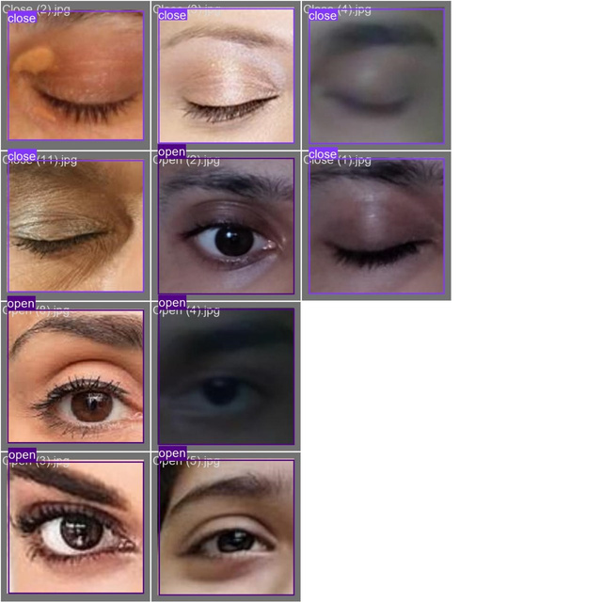
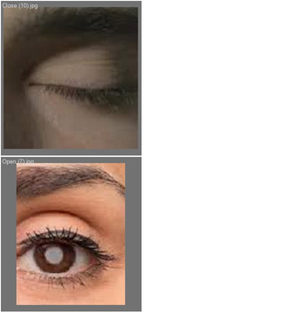
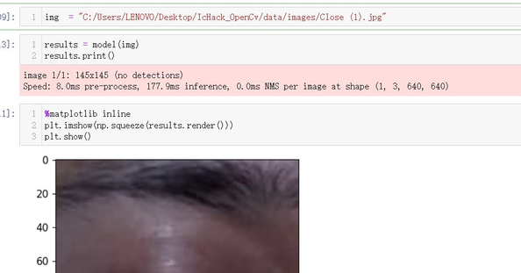
USE OF CNN
IN DRIVER DROWSINESS DETECTION
CNNs are a class of deep learning models particularly suited for image and video analysis tasks
Feature Extraction
Spatial Hierarchies
Weight Sharing
Pooling Layers
Non-Linearity
Local Receptive Fields
Transfer Learning
Custom Architectures
Data Augmentation
Hyperparameter Tuning
Evaluation Metrics
Real-Time Processing

Slide 11
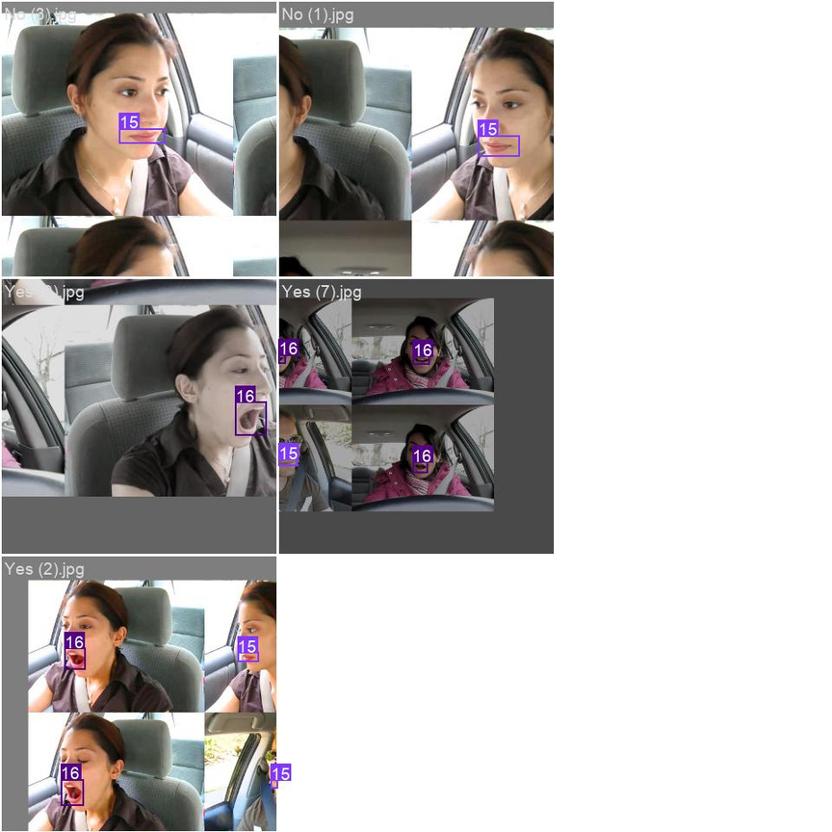
MODEL PERFORMANCE METRICS
BLINKING DETECTION
YAWNING DETECTION
ACCURACY :
97%
ACCURACY :
98.65%
PRECISION :
96.75%
PRECISION :
99.2%
RMSE :
62%
RMSE :
71%
F-SCORE :
0.935
F-SCORE :
0.981

Slide 12
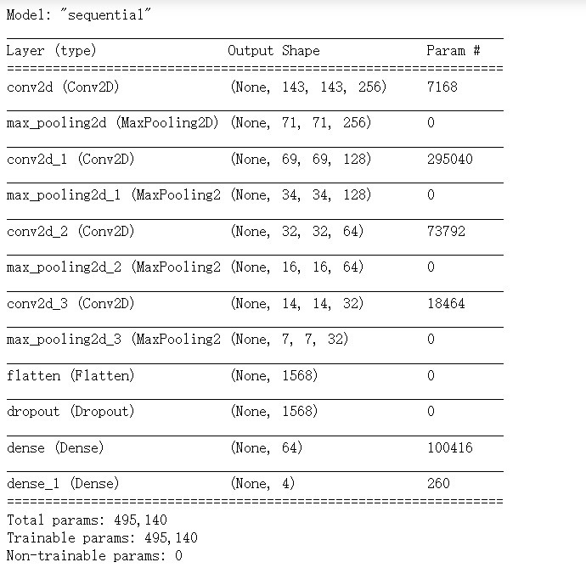
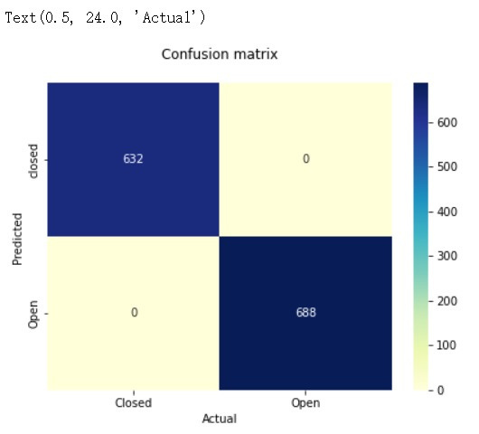
MODEL PERFORMANCE METRICS

Slide 13




INNOVATIONS
FEATURES
FEATURES
FEATURES
Real-Time Detection
Multi-Modal Sensing
Adaptive AI
Seamless Integration
Privacy and Data Security
Scalability
User-Friendly Interface
Customized Alerts
Energy Efficiency

Slide 14

FUTURE SCOPE
ADVANCED SENSOR INTEGRATION
AI and ML Advancements
Edge Computing Optimization
IoT and Connectivity
Personalized Alerts
Predictive Analytics
AI-Powered Driver Assistance
Behavioral Biometrics
Global Expansion
Fleet Management Integration
FINANCIAL PROJECTIONS:
Revenue projections for the next 3-5 years indicate steady growth, with expected annual revenues of $7.1B by Year 2028.
Cost structure includes R&D, marketing, and operational expenses, with profitability expected by Year 2030.

Slide 15
Thanks!

